Slide 1
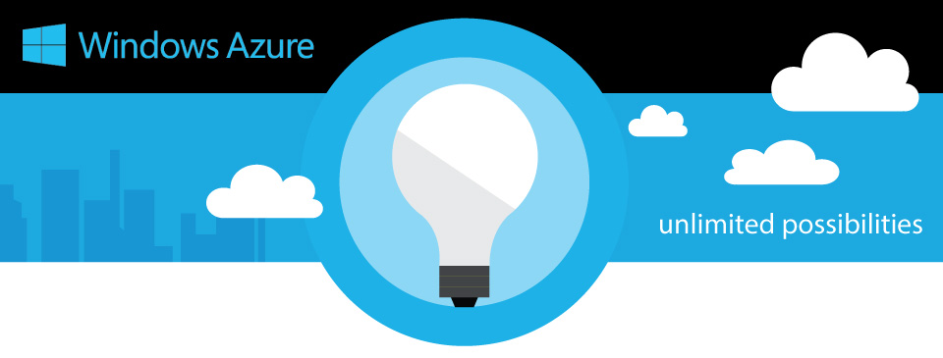


Slide 2
Introduction to Windows Azure
How to setup a website in Azure
WebApp creation
SQL Database Creation
Deployment of site from Visual studio (Using Azure Profile)
Feature’s in Azure

Slide 3
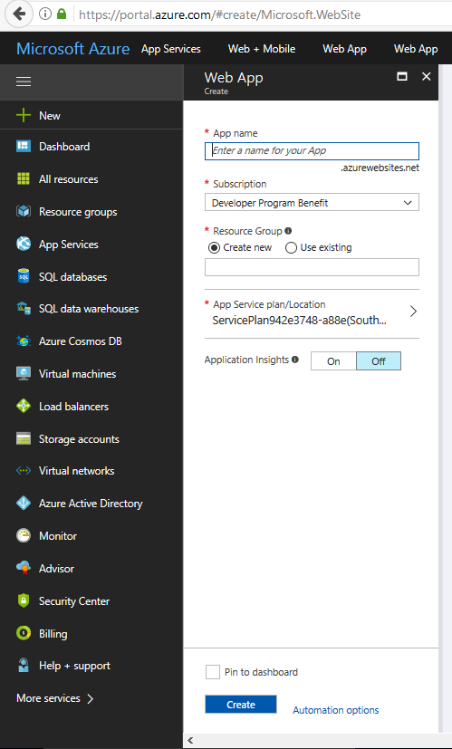
Webapp creation
App Name
Subscription
Resource Group
App Service plan/Location
Application Insights

Slide 4
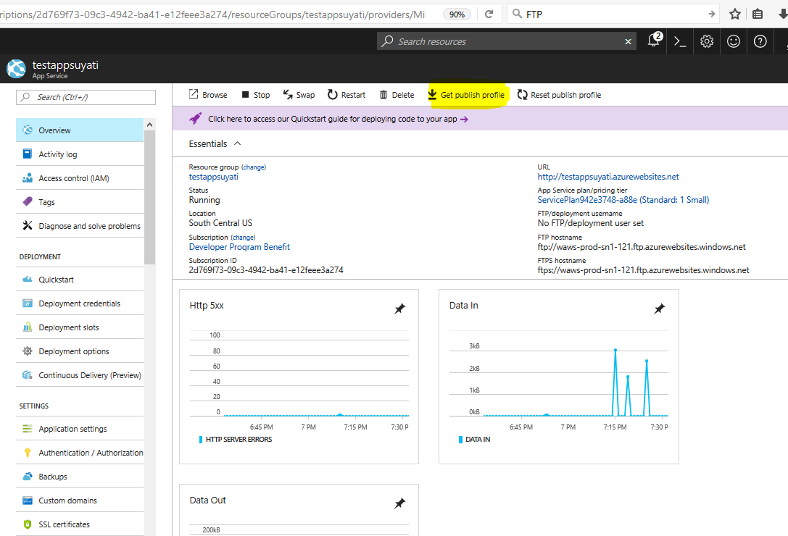
Download Profile
Deployment of developed web application to azure can be done with help of profile.
Which contain FTP username/password (FTP used for the transfer of computer files between a client and server on a computer network)

Slide 5
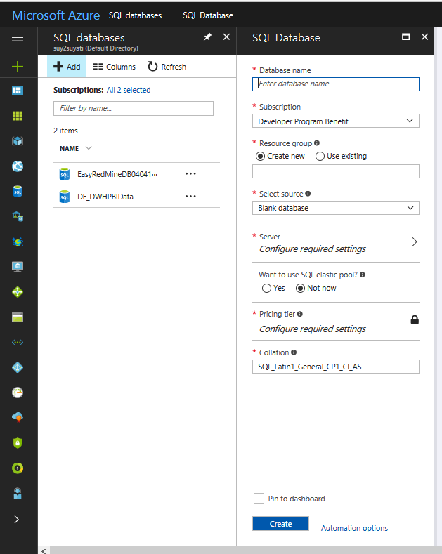
MS Sql DB Setup
Creating database

Slide 6
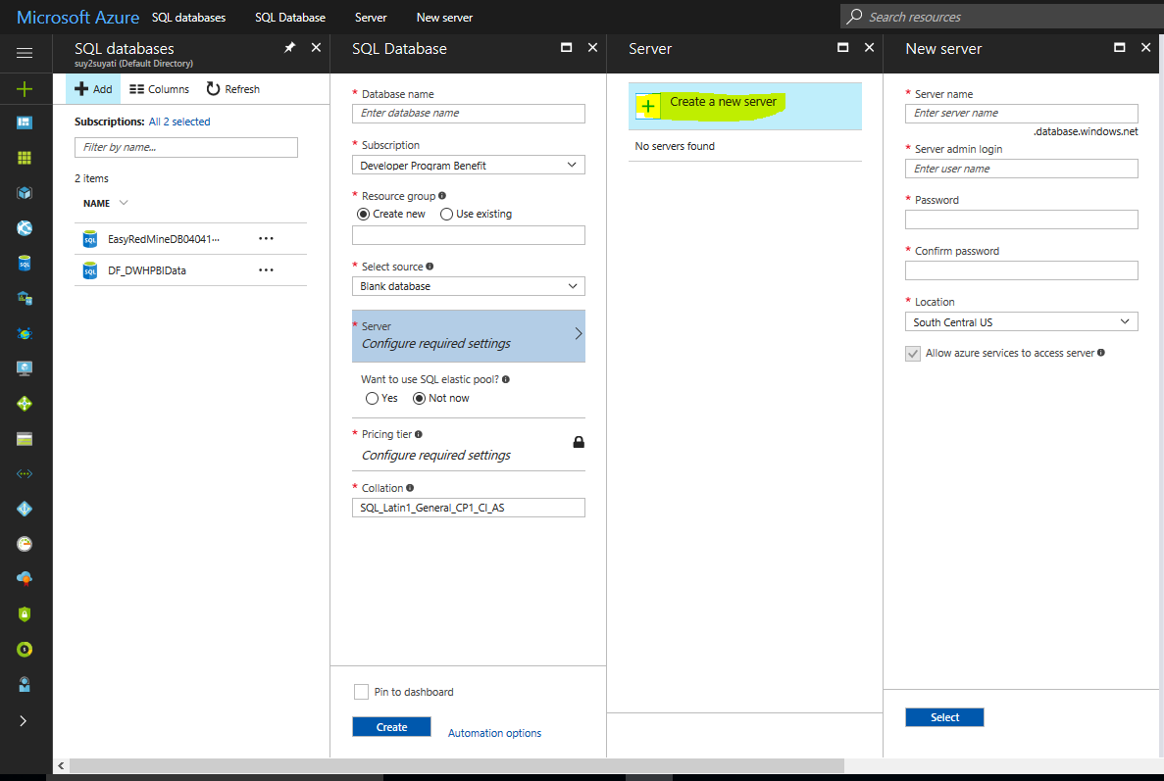
Creating Db Server

Slide 7
Deployment of site from Visual studio (Using Azure Profile)

Slide 8
Feature’s in Azure
Azure Function

